Slide 1

Crop Recommendation using ML
GROUP – D11

Slide 2


Guided By
Presented By
PRIYA KHETAN
ANURAG THAKUR
PIYUSH KUMAR
RASHMITA PANIGRAHI

Slide 3

INTRODUCTION
Crop recommendation in agriculture science is the primary concern for every country, as the food demand is increasing at a fast rate due to an increase in population. Moreover, the increased use of technology today has increased the efficiency and accuracy of detecting diseases in crops. Most of the times it is observed that farmers tend to sow the crop according to its market value and possible financial profits rather than taking factors like soil conditions, sustainability etc. in to the account. The detection process marks the beginning of a series of activities to fight the diseases and reduce their spread. Some diseases are also transmitted between plants, making it hard to fight them.

Slide 4
Objectives
The proposed model predicts the crop yield for the data sets of the given region. Integrating agriculture and ML will contribute to more enhancements in the agriculture sector by increasing the yields and optimizing the resources involved. The data from previous years are the key elements in forecasting current performance.
The proposed system uses recommender system to suggest the right time for using fertilizers.
The methods in the proposed system includes increasing the yield of crops, real-time analysis of crops, selecting efficient parameters, making smarter decisions and getting better yield.
The main objective is to obtain a better variety of crops that can be grown over the season. The proposed system would help to minimize the difficulties faced by farmers in choosing a crop and maximize the yield.

Slide 5
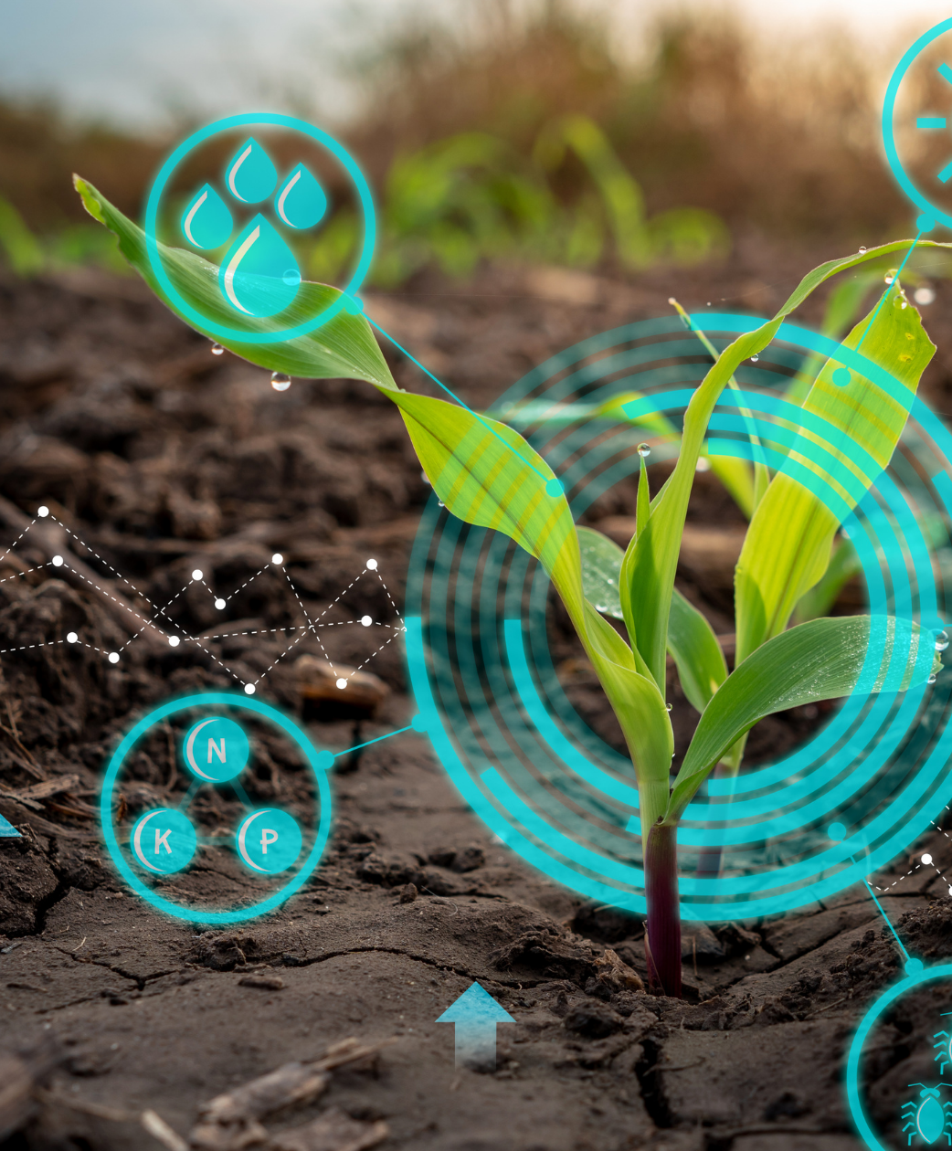
Tools& Resources
Software Tools:-
Google Collab (Developer Tool)
VS Code
Windows 11 (OS )
Language (Python)
Web Framework (Flask)
Hardware Tools:-
RYGEN 7 Octa Core processor
Dataset:
Crop Recommendation (Kaggle)

Slide 6
MODELS-
Linear Regression:-
Linear regression is used to establish a relationship between various environmental variables like temperature, rainfall, etc and the crop yield. It is important to measure the possible production of rate of crop and the farmers will be benefitted by the result of this prediction.
2. SVM:-
SVM stands for Support Vector Machines. It is used to classify the crop based on the factors of area.
And as we are also implementing a Web Model that enables the user to interact with the model and make their prediction successful with their given inputs.
3. Decision Tree Classifier:-
This model will used to predict the future values of four meterological variables like min. Temp, , max. Temp., Relative Humidity, Sunshine and Rainfall.

Slide 7
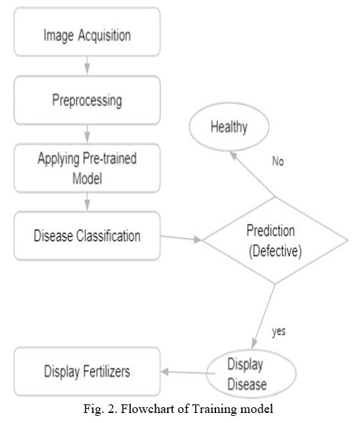
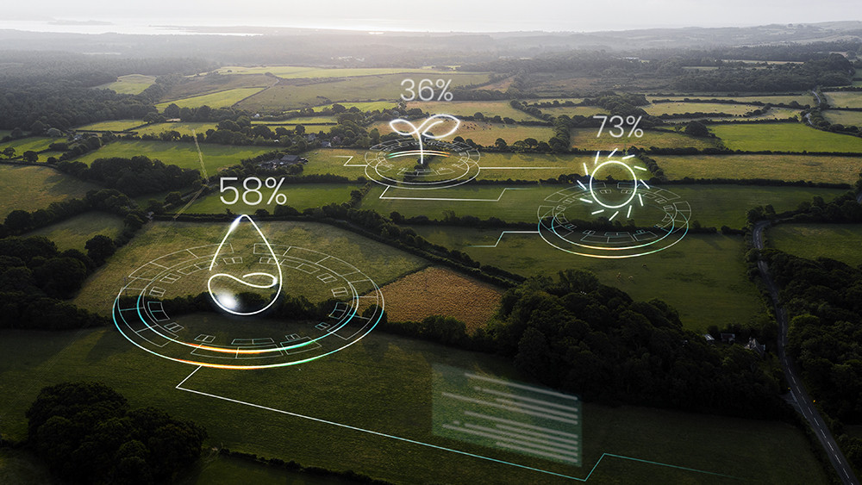

Flowchart:
Input

Slide 8
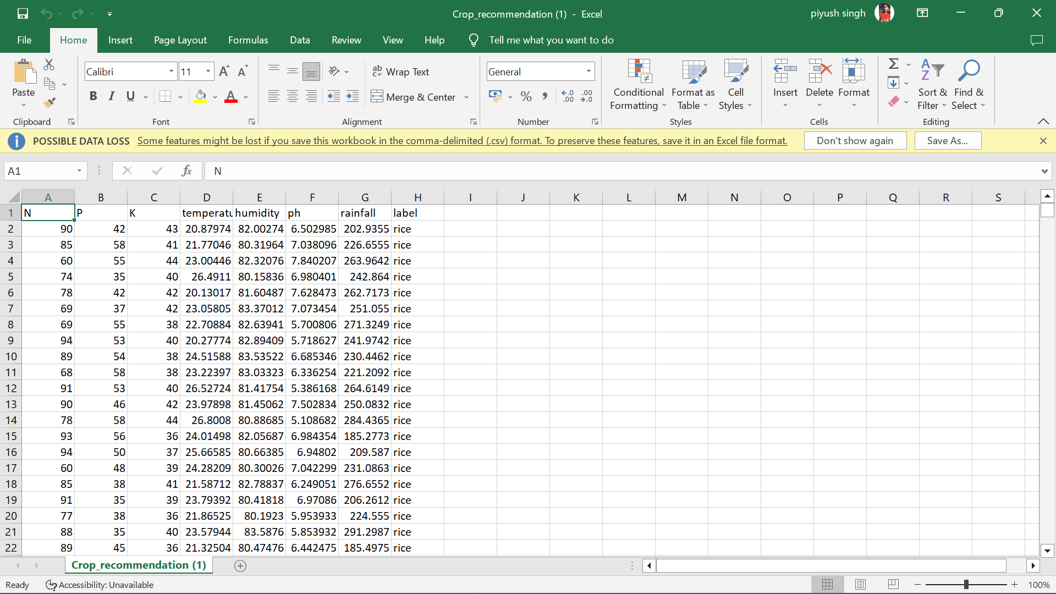
DATASET.

Slide 9
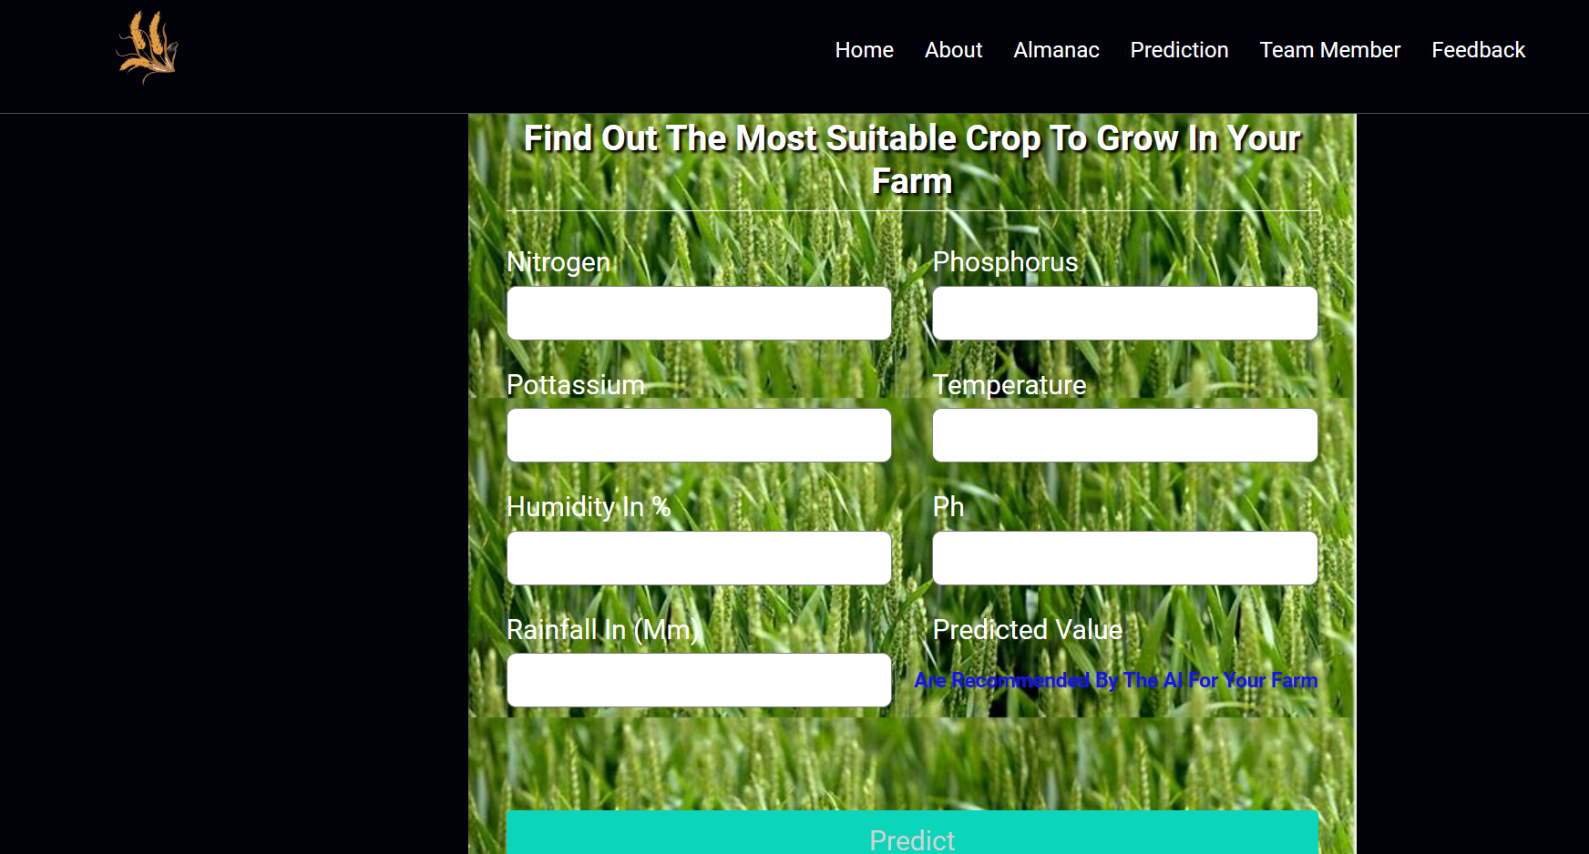
Project (Web Application)

Slide 10
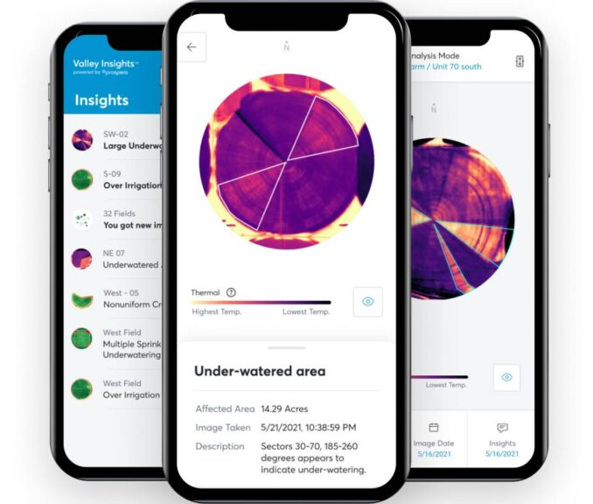



Future Scope
At present we have limited our scope only to a crop recommendation system, but this in the future can be extended to other areas such as fertilizer recommendations, wherein a person can get the information of the fertilizer suitable for his crop. Another extended application of this could be plant disease classification using CNN and also giving a remedy to that disease. As agriculture is quite an unexplored area, the scope for such a type of project is tremendous. While we have made a working website for our model, in the future this can also be made into an app so that it is easier for the farmers to access. Both the website and the app can be made in regional languages so that people would be more comfortable using them.

Slide 11


Thank You.

